Slide 1



Unit I Introduction to Algorithm and Data Structures (05 Hours)
1

Slide 2
Syllabus
Introduction: From Problem to Data Structure (Problem, Logic, Algorithm, and Data Structure).
Data Structures: Data, Information, Knowledge, and Data structure, Abstract Data Types (ADT),
Data Structure Classification (Linear and Non-linear, Static and Dynamic, Persistent and Ephemeral data structures)
Algorithms: Problem Solving, Introduction to algorithm, Characteristics of algorithm, Algorithm design tools: Pseudo-code and flowchart
Complexity of algorithm: Space complexity, Time complexity, Asymptotic notation- Big-O, Theta and Omega, Finding complexity using step count method,
Analysis of programming constructs-Linear, Quadratic, Cubic,
Logarithmic.
Algorithmic Strategies- Introduction to algorithm design
2
strategies- Divide and Conquer, and Greedy strategy.

Slide 3
Introduction
From Problem to Data Structure (Problem, Logic, Algorithm, and Data Structure).

Slide 4

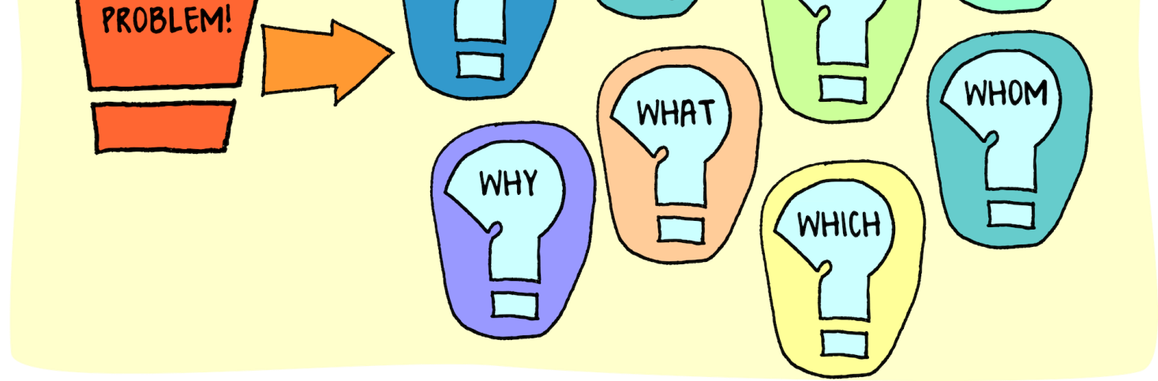
What is Problem Solving and Why is it Important?

Slide 5
What is Problem Solving and Why is it Important?
The ability to solve problems is a basic life skill and is essential to our day-to-day lives, at home, at school, and at work.
We solve problems every day without really thinking about how we solve them.
For example: it’s raining and you need to go to the store. What do you do? There are lots of possible solutions. Take your umbrella and walk. If you don't want to get wet, you can drive, or take the bus. You might decide to call a friend for a ride, or you might decide to go to the store another day. There is no right way to solve this problem and different people will solve it differently.

Slide 6
Why should we learn Data Structures?
Data Structures and Algorithms are two of the key aspects of Computer Science.
Data Structures allow us to organize and store data, whereas Algorithms allow us to process that data meaningfully.
Learning Data Structures and Algorithms will help u become better Programmers.
You will be able to write code that is more effective and reliable.
You will also be able to solve problems more quickly and efficiently.

Slide 7
Problem Solving
“Problem is defined as situation or condition which needs to solve to achieve goal
Problem solving is the process of identifying a problem, developing possible solution paths, and taking the appropriate course of action.
Problem solving is the application of ideas, skills, or factual information to achieve the solution to a problem or to reach a desired outcome.

Slide 8
Basic Terms
Data − Data are values or set of values.
Data Item − Data item refers to single unit of values.
Group Items − Data items that are divided into sub items are called as Group Items.
Elementary Items − Data items that cannot be divided are called as Elementary Items.
Attribute and Entity −An entity is that which contains certain attributes or properties, which may be assigned values.
Entity Set − Entities of similar attributes form an entity set.
Field − Field is a single elementary unit of information representing an attribute of an entity.
Record − Record is a collection of field values of a given entity.
File − File is a collection of records of the entities in a given entity set.

Slide 9
Data
Data, Information, Knowledge, and Data structure, Abstract Data Types (ADT),

Slide 10
Data
Data" to refer to Computer Information, either transmitted or stored
Data is a raw and unorganized fact that is required to be processed to make it meaningful.
Data are individual units of information
In analytical processes, data are represented by variables.
Data is always interpreted, by a human or machine, to derive meaning. So, data is meaningless. Data contains numbers, statements, and characters in a raw form.

Slide 11
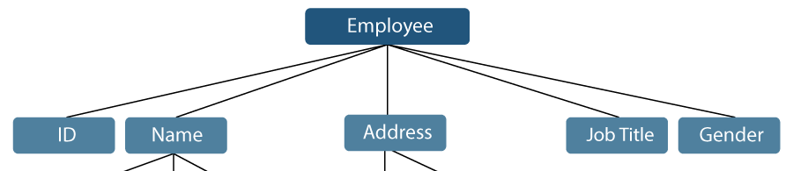

Example
In the example mentioned above, the items such as ID, Age, Gender, First, Middle, Last, Street, Locality, etc., are elementary data items. In contrast, the Name and the Address are group data items.

Slide 12
Information
Information is processed, organized, and structured data.
We use the information in significant ways.
A researcher can evaluate their hypothesis on the basis of collected data. A businessman analyzes, organizes the collected data, and makes business decisions.
12

Slide 13

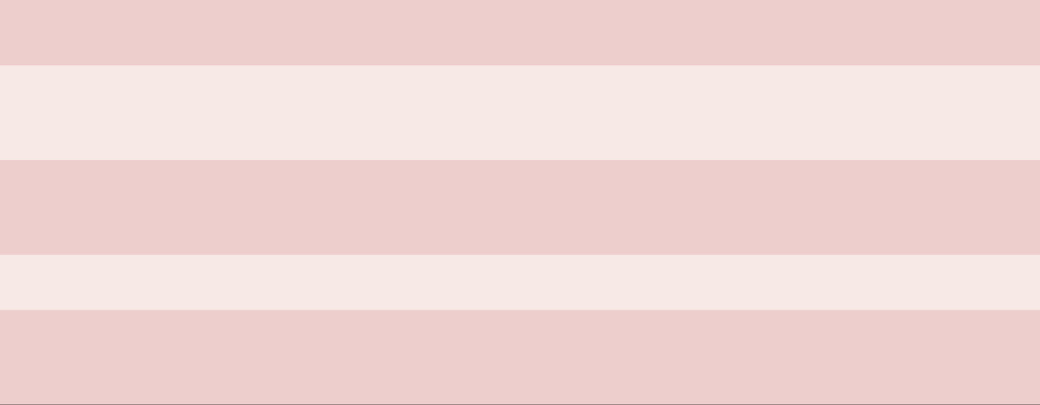
Data and information
Data
Data refers to raw facts that have no meaning
Data is independent of information Data is not enough to take a decision.
In raw form and unprocessed and unstructured We cannot make a decision based on the data
Data is normally huge in volume
₁₃Data is not always useful as it is needed to be processed
Information
Information refers to processed data that has purpose and meanings.
Information is dependent on data
The information is sufficient to help to make a decision in the respective context
Processed and structured
Meaningful data, i e Information can be used to make decisions.
Information is normally short in volume
Information is always useful as it provides some meaning

Slide 14
Knowledge
Knowledge is what we know.
Knowledge is unique to each individual and is the accumulation of past experience and insight that shapes the lens by which we interpret, and assign meaning to, information.
For knowledge to result in action, an individual must have the authority and capacity to make and implement a decision.
Knowledge (and authority) are needed to produce actionable information that can lead to impact.
14

Slide 15
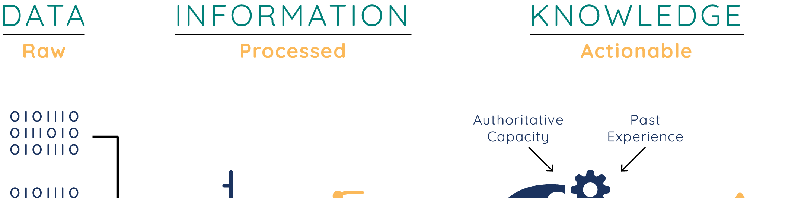
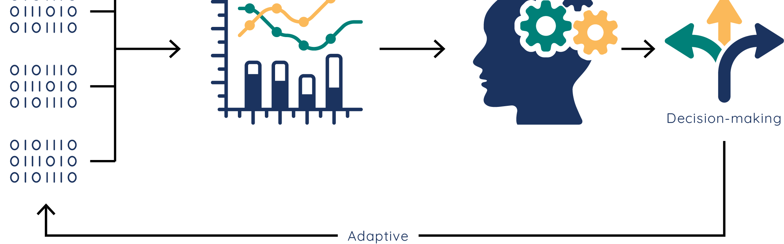
Data, Information and Knowledge
15
Figure 1:The flow from data to information to knowledge.

Slide 16
Data Types
Data type refers to the kind of data a variable may store. Whenever we try to implement any algorithm in some programming language, we need variables.
A variable may have any value as per the facilities provided by that language. Data type is a term that specifies the type of data that a variable may hold in the programming language.
Built in Data Type-int ,float ,char etc.
User Defined Data Type : Class, structure, and union

Slide 17
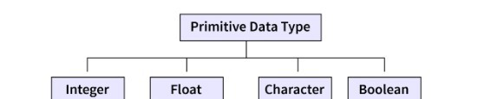
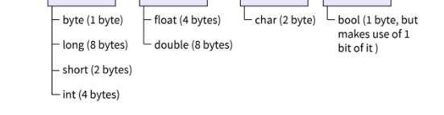
Data Type and their Size

Slide 18
Data Structure
Data Structure is a particular way of storing and organizing data in the memory of the computer so that these data can easily be retrieved and efficiently utilized in the future when required.
The data can be managed in various ways, like the logical or mathematical model for a specific organization of data is known as a data structure.

Slide 19
Abstract Data Types (ADT)
To simplify the process of solving problems, we can create data structures along with their operations, and such data structures that are not in-built are known as Abstract Data Type (ADT).
Abstract Data type (ADT) is a type (or class) for objects whose behavior is defined by a set of values and a set of operations. The definition of ADT only mentions what operations are to be performed but not how these operations will be implemented. It does not specify how data will be organized in memory and what algorithms will be used for implementing the operations. It is called “abstract” because it gives an implementation-independent view.

Slide 20
Algorithm
An algorithm is a collection of steps to solve a particular problem. Learning data structures and algorithms allow us to write efficient and optimized computer programs.
20

Slide 21
Data Structure Classification/ Types of Data Structure
Linear and Non-linear, Static and Dynamic, Persistent and Ephemeral data structures
21

Slide 22
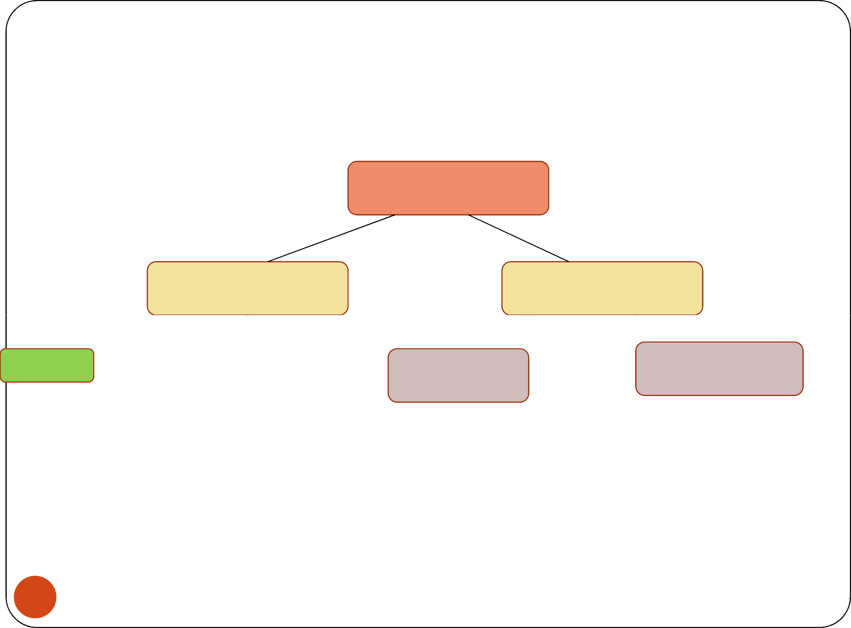
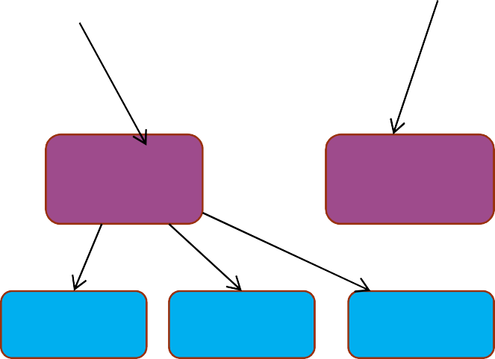
Data Structure Classification/ Types of Data Structure
Data Structure
Primitive Data Structure
Non Primitive Data Structure
Int
Linear Data Structure
Non Linear Data Structure
Boolean
Char
Float
Static
Dynamic
Tree
Graph
Linked List
Stack
Queue
22
Array

Slide 23
Primitive and Non-primitive Data Structures
Primitive data structures are the fundamental data types which are supported by a programming language. Eg. integer, real, character, and boolean.
Non-primitive data structures are those data structures which are created using primitive data structures. Eg. linked lists, stacks, trees, and graphs, class, structure
Non-primitive data structures can further be classified into two categories: linear and non-linear data structures.
23

Slide 24
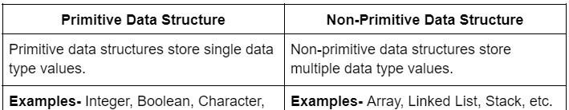
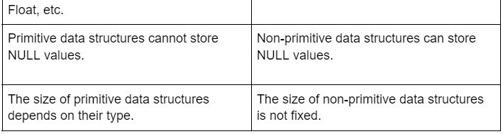
Primitive VS Non Primitive Data Structure
24

Slide 25
Linear and Non-linear Structures
If the elements of a data structure are stored in a linear or sequential order, then it is a linear data structure. Eg. arrays, linked lists, stacks, and queues
If the elements of a data structure are not stored in a sequential order, then it is a non-linear data structure. Eg. Tree and Graphs.
In non-linear data structures, every data element may have more than one predecessor as well as successor. Elements do not form any particular linear sequence.
Non-linear data structures are generally implemented in the same way as linked lists. Hence, trees and graphs can be implemented as dynamic data structures.

Slide 26

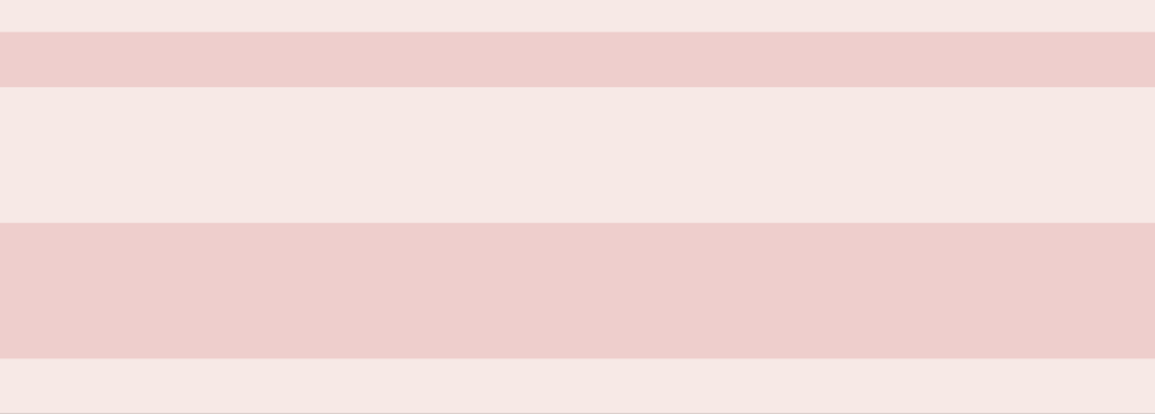
Linear VS Non Linear
Linear Data Structures | Non Linear Data Structures
Linear Data Structures used to represent sequential data. | Non Linear Data Structures used to represent hierarchical data.
Linear Data Structures are easy to implement. | Non Linear Data Structures are difficult to implement
Implemented using array and linked list | Mostly implemented using linked list
These are mostly used in application of software development | These are mostly used in application of graph theory, AI, Image processing
For implementation of linear DS we don’t need Non Linear Data Structure | For implementation of Nonlinear DS we need Linear Data Structure
Eg. List, Stack,Queue | Eg.Trees and Graph

Slide 27
Static and Dynamic Data Structures
A data structure is referred to as a static data structure if it is created before program execution begins (also called during compilation time). The variables of static data structure have user-specified names. Eg. Array
A data structure that is created at run-time is called dynamic data structure. The variables of this type are not always referenced by a user-defined name. These are accessed indirectly using their addresses through pointers. Eg. Linked List, Stack, Queue
27

Slide 28

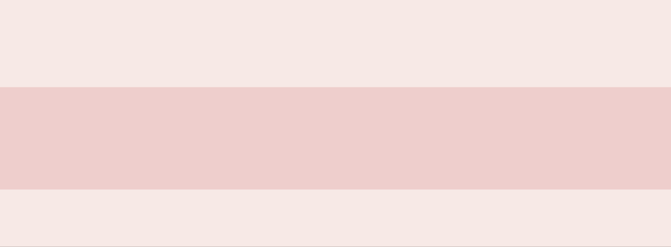
Static VS Dynamic Data Structures
Static Data Structures | Dynamic Data Structures
A data structure whose size is fixed when it is created in memory | Data structure which will extend and change its size to fit the data
Inefficient as memory is allocated that is not needed | Efficient as the amount of memory varies
Fast access to the data as memory location is fixed when the program is written | Slower access to each element as the memory location is allocated at run time
Eg. Array | Eg. Linked List

Slide 29
Persistent and Ephemeral Data Structures
A data structure that supports operations on the most recent version as well as the previous version is termed as a persistent data structure. Eg. Magnetic media, such as hard disk drives and tape.
A data structure is partially persistent if all versions can be accessed but only the newest version can be modified. Fully persistent if every version can be both accessed and modified. Confluently persistent is when we merge two or more versions to get a new version.
An ephemeral data structure is one that supports operations only on the most recent version. Eg. soap bubbles ,Linked List, array

Slide 30
Algorithm
Problem Solving, Introduction to algorithm, Characteristics of algorithm, Algorithm design tools: Pseudo-code and flowchart
30

Slide 31
Problem Solving
A problem-solving algorithm is a procedure that is guaranteed to produce a solution if it is followed strictly.
Problem solving is the act of defining a problem; determining the cause of the problem identifying prioritizing and selecting alternatives for a solution; and implementing a solution.The problem-solving process.
https://asq.org/quality-resources/problem- solving#:~:text=Problem%20solving%20is%20the%20act,The%20problem%2Dsolving%20pr
₃₁ ocess

Slide 32
Classification of Problems
​ 1) Problems based on Algorithmic Solutions:
​ Include Step by step Instructions and Series of actions
eg: To find fibonacci series –Sequence of steps/actions are required.
​ 2) Problems based on Heuristic Solutions:
​ Trial and Error form
No sequence of actions or instructions
eg:1)Common Sense Heuristic: If it is raining outside, you should bring an umbrella.
2) Familiarity Heuristic :Consumers buy the same brands over and over regardless of the quality of the products

Slide 33
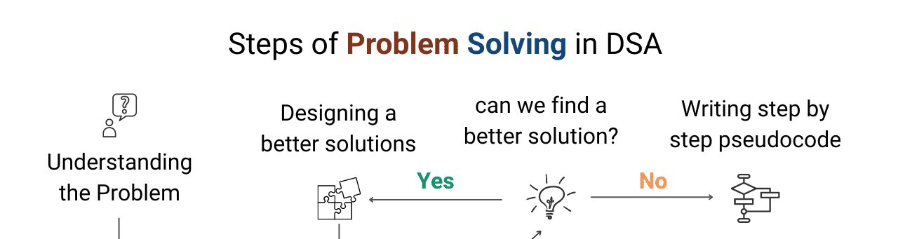
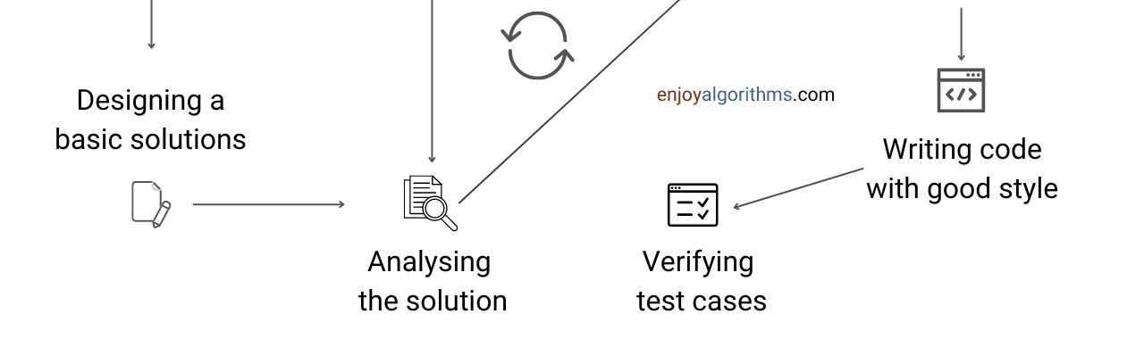
Steps of Problem solving in DSA

Slide 34
Introduction to Algorithm
An algorithm is simply a set of steps used to complete a specific task.
An algorithm is a set of step-by-step procedures, or a set of rules to follow, for completing a specific task or solving a particular problem. gorithm is a set of rules that specify the order and kind of arithmetic operations that are used on a specified set of data.
An algorithm is an effective method for solving a problem using a finite sequence of instructions.

Slide 35
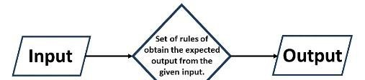

Algorithm

Slide 36
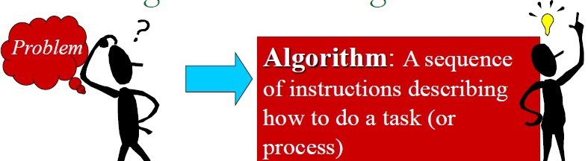

From Algorithm to process

Slide 37
Characteristics of Algorithm
Input − An algorithm should have 0 or more well-defined inputs.
Output − An algorithm should have 1 or more well-defined
outputs, and should match the desired output.
Finiteness − Algorithms must terminate after a finite number of steps.
Feasibility − Should be feasible with the available resources.
Independent − An algorithm should have step-by-step directions, which should be independent of any programming code.
Unambiguous − Algorithm should be clear and unambiguous. Each of its steps (or phases), and their inputs/outputs should be clear and must lead to only one meaning.
37

Slide 38
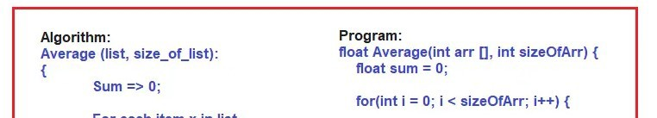
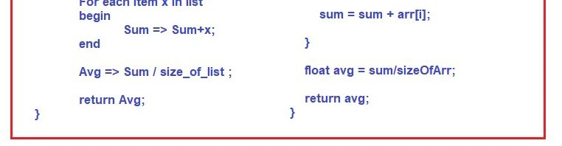
Algorithm and Program

Slide 39
Pseudo code
Pseudocode is a method of describing computer algorithms using a combination of natural language and programming language. It is essentially an intermittent step towards the development of the actual code.

Slide 40
Pseudo code for addition of two numbers
Pseudocode to Add Two Numbers
BEGIN.
NUMBER s1, s2, sum. OUTPUT("Input number1:") INPUT s1.
OUTPUT("Input number2:") INPUT s2.
sum=s1+s2. OUTPUT sum.
40

Slide 41
Flowchart
A flowchart is a schematic representation of an algorithm or a stepwise process, showing the steps as boxes of various kinds, and their order by connecting these with arrows. Flowcharts are used in designing or documenting a process or program.
A flow chart, or flow diagram, is a graphical representation of a process or system that details the sequencing of steps required to create output.
41

Slide 42
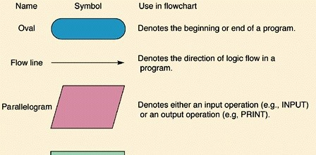
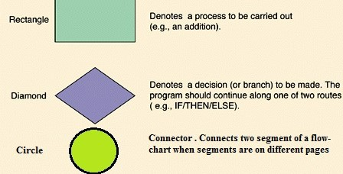

Slide 43
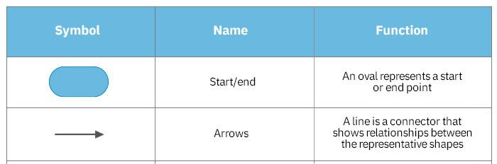
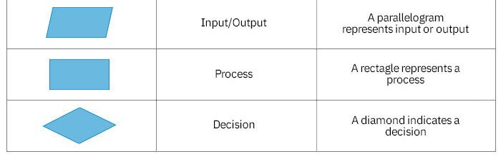

Slide 44
Algorithm for addition of two number
Input : Two numbers num1 and num2
Step 1: Start
Step 2: Declare sum to 0 (This is optional step, during step5 we can add declaration and assign directly as well)
Step 3: Read number num1
Step 4: Read number num2
Step 5: Add num1 and num2 and assign result to variable sum
Step 6: Print sum
Step 7: Stop
Output: Sum of num1 and num2

Slide 45
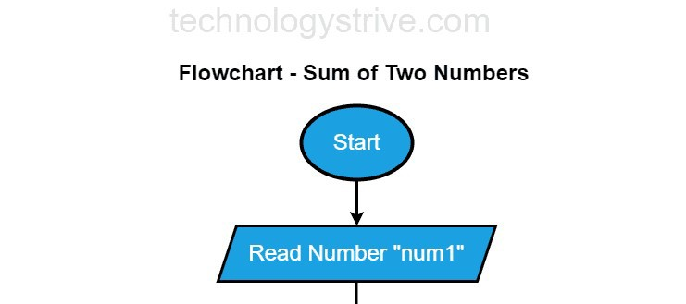
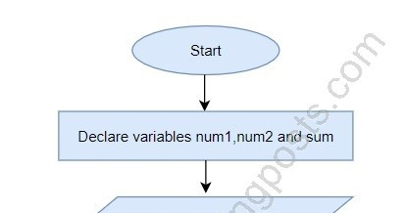
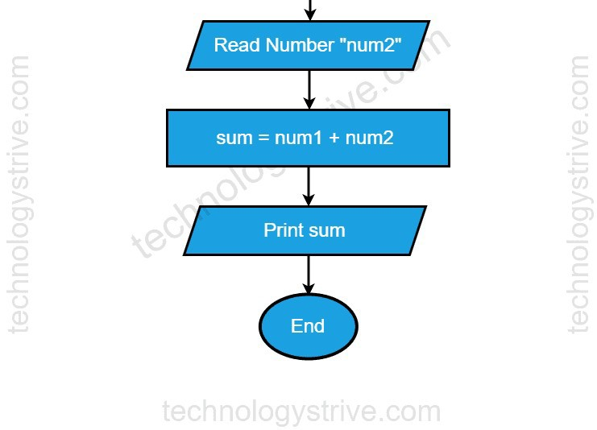
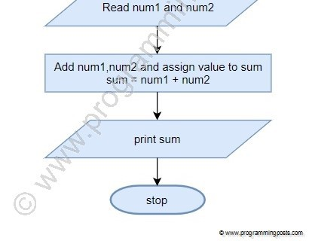
Flowchart for addition of two number

Slide 46
Complexity of algorithm:
Space complexity Time
complexity Theta and using step
Asymptotic notation- Big-O,
Omega, Finding complexity count method,

Slide 47
Time Complexity
The field of computer science, which studies efficiency of algorithms, is known as analysis of algorithms.
Time Complexity is the amount of time taken by the algorithm to run. It measures the time taken to execute each statement of code in an algorithm.
Time Complexity can be calculated by using Two types of methods.They are:
Step Count Method
Asymptotic Notation.
47

Slide 48
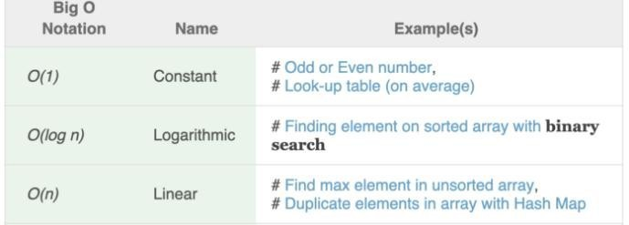
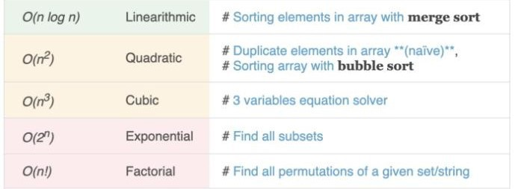
4

Slide 49
Space Complexity
Problem-solving using computer requires memory to hold temporary data or final result while the program is in execution. The amount of memory required by the algorithm to solve given problem is called space complexity of the algorithm.
The space complexity of an algorithm quantifies the amount of space taken by an algorithm to run as a function of the length of the input
To estimate the memory requirement we need to focus on two parts:
(1) A fixed part: It is independent of the input size. It includes memory for instructions (code), constants, variables, etc.
(2) A variable part: It is dependent on the input size. It includes memory for recursion stack, referenced variables, etc.

Slide 50
Asymptotic Notation
Asymptotic Notations are programming languages that allow you to analyze an algorithm's running time by identifying its behavior as its input size grows.This is also referred to as an algorithm's growth rate.
Asymptotic notation of an algorithm is a mathematical representation of its complexity.
Asymptotic notations are classified into three types:
Big-Oh (O) notation
Big Omega ( Ω ) notation
Big Theta ( Θ ) notation
50

Slide 51
Asymptotic Notation
O notation: asymptotic “less than”: upper bound
f(n)=O(g(n)) implies: f(n) “≤” g(n) worst-case complexity
Ω notation: asymptotic “greater than”: Lower bound
f(n)= Ω (g(n)) implies: f(n) “≥” g(n) Best case Complexity
Θ notation: asymptotic “equality”:
f(n)= Θ (g(n)) implies: f(n) “=” g(n) average-case Complexity
51

Slide 52
Big Oh Notation
Big-O notation represents the upper bound of the running time of an algorithm. Therefore, it gives the worst-case complexity of an algorithm.
.It is the most widely used notation for Asymptotic analysis.
.It specifies the upper bound of a function.
.The maximum time required by an algorithm or the worst-case time complexity.
It returns the highest possible output value(big-O) for a given input.
Big-Oh(Worst Case) It is defined as the condition that allows an algorithm to complete statement execution in the longest amount of time possible.

Slide 53
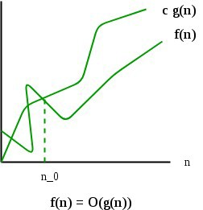
Big Oh Notation
If f(n) describes the running time of an algorithm, f(n) is O(g(n)) if there exist a positive constant C and n0 such that, 0 ≤ f(n) ≤ cg(n) for all n ≥ n0
It returns the highest possible output value (big- O)for a given input.
The execution time serves as an upper bound on the algorithm’s time complexity.

Slide 54

Example
Consider the following f(n) and g(n)...
f(n) = 3n + 2 g(n) = n
If we want to represent f(n) as O(g(n)) then it must
satisfy f(n) <= C g(n) for all values of C > 0 and n₀>= 1
f(n) <= C g(n) 3n + 2 <= C n
Above condition is always TRUE for all values of C = 4 and n
>= 2.
By using Big - Oh notation we can represent the time complexity as follows...
3n + 2 = O(n)

Slide 55
Omega Notation (Ω-Notation):
Omega notation represents the lower bound of the running time of an algorithm. Thus, it provides the best case complexity of an algorithm.
The execution time serves as a lower bound on the algorithm’s time complexity.
It is defined as the condition that allows an algorithm to complete statement execution in the shortest amount of time.

Slide 56
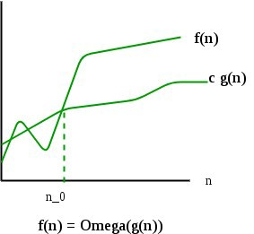
Mathematical Representation of Omega Notation (Ω-Notation):
Let g and f be the function from the set of natural numbers to itself. The function f is said to be Ω(g), if there is a constant c
> 0 and a natural number n0 such that c*g(n) ≤ f(n) for all n
≥ n0
Ω(g(n)) = { f(n): there exist positive constants c and n0 such that 0 ≤ cg(n) ≤ f(n) for all n ≥ n0 }

Slide 57
Example
Consider the following f(n) and g(n)...
f(n) = 3n + 2 g(n) = n
If we want to represent f(n) as Ω(g(n)) then it must satisfy f(n) >= C g(n) for all values of C > 0 and n₀>= 1 f(n) >= C g(n)
3n + 2 >= C n
Above condition is always TRUE for all values of
C = 1 and n >= 1.
By using Big - Omega notation we can represent the time complexity as follows...
3n + 2 = Ω(n)
57

Slide 58
Theta Notation (Θ-Notation):
Theta notation encloses the function from above and below. Since it represents the upper and the lower bound of the running time of an algorithm, it is used for analyzing the average-case complexity of an algorithm.
Theta (Average Case) You add the running times for each possible input combination and take the average in the average case.

Slide 59
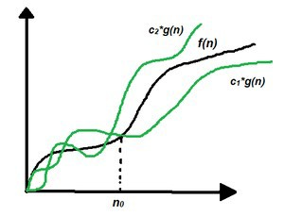
Mathematical Representation of Theta notation:
Let g and f be the function from the set of natural numbers to itself. The function f is said to be Θ(g), if there are constants c1, c2 > 0 and a natural number n0 such that
c1* g(n) ≤ f(n) ≤ c2 * g(n) for all n ≥ n0
Θ (g(n)) = {f(n) there exist positive constants c1 c2 and n0 such that 0 ≤ c1 * g(n) ≤ f(n) ≤ c2 * g(n) for all n ≥ n0}

Slide 60

Example
​ Consider the following f(n) and g(n)...
f(n) = 3n + 2 g(n) = n
If we want to represent f(n) as Θ(g(n)) then it must
satisfy C₁ g(n) <= f(n) <= C₂ g(n) for all values of C₁ > 0, C₂ > 0 and n₀>= 1
C₁ g(n) <= f(n) <= C₂ g(n)
C₁ n <= 3n + 2 <= C₂ n
Above condition is always TRUE for all values of C₁ = 1, C₂ = 4 and n >= 2.
By using Big - Theta notation we can represent the time compexity as follows...
3n + 2 = Θ(n)
60

Slide 61
Step Count Method
The step count method is one of the method to analyze the algorithm. In this method, we count number of times one instruction is executing. From that we will try to find the complexity of the algorithm.
Suppose we have one algorithm to perform sequential search. Suppose each instruction will take c1, c2, …. amount of time to execute, then we will try to find out the time complexity of this algorithm
The step Count method is also called as Frequency Count method.
61

Slide 62
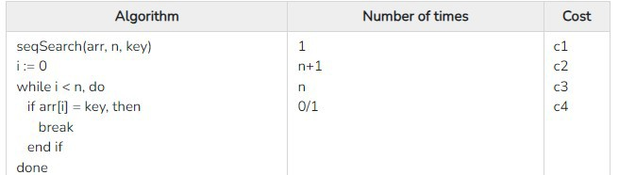
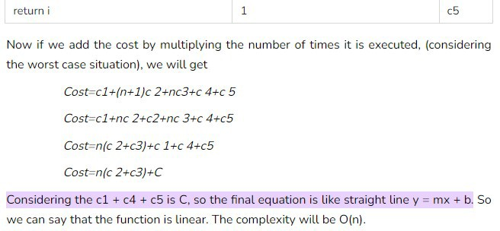
Time Complexity

Slide 63
Time and Space Complexity for addition of two numbers
The time complexity of the problem addition of two numbers in C/C++ is O(1) because it doesn't depend on the input values.
The space is only taken to store the two variables and their sum hence the space complexity for a program to find the addition of two numbers in C is O(1).

Slide 64
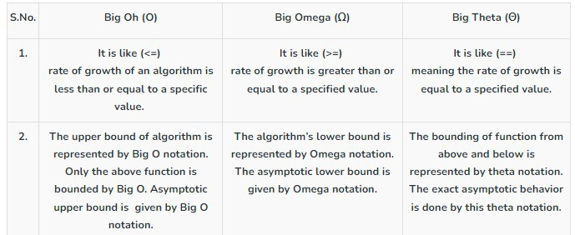
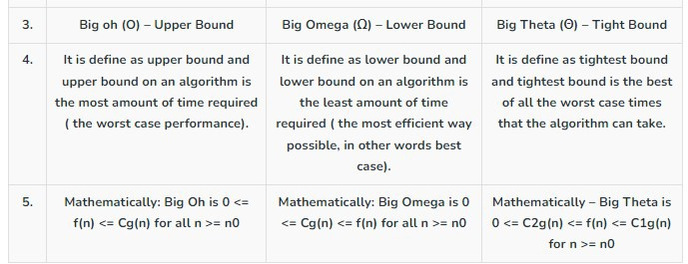

Slide 65
Analysis of programming constructs- Linear
Quadratic, Cubic, Logarithmic.

Slide 66
Algorithmic Strategies-
Introduction to algorithm design strategies- Divide and Conquer, and Greedy strategy.

Slide 67
Algorithm design Strategies
Divide and conquer algorithms – divide the problem into smaller subproblems of the same type; solve those smaller problems, and combine those solutions to solve the original problem. Eg. Binary Search, Quick Sort, Merge Sort
Greedy algorithms – find an optimal solution at the local level with the intent of finding an optimal solution for the whole problem. Eg. Job Scheduling, Activity selection, Fractional Knapsack, MST, Huffman Code

Slide 68
Algorithm design Strategies
Backtracking algorithms – divide the problem into subproblems, each which can be attempted to be solved; however, if the desired solution is not reached, move backwards in the problem until a path is found that moves it forward. Eg. 8 Queen Problem, Sum of Subset, Graph Coloring
Dynamic programming algorithms – break a complex problem into a collection of simpler subproblems, then solve each of those subproblems only once, storing their solution for future use instead of re-computing their solutions. Eg. OBST,0/1 knapsack problems

Slide 69
Algorithm design Strategies
Brute force algorithms – try all possible solutions until a satisfactory solution is found.eg. Sequential Search, Bubble Sort
Randomized algorithms – use a random number at least once during the computation to find a solution to the problem. Eg. Randomized quick sort
Recursive algorithms – solve the lowest and simplest version of a problem to then solve increasingly larger versions of the problem until the solution to the original problem is found. Eg. Factorial of number, merge sort, quick sort

Slide 70
Divide and Conquer
Divide and Conquer is an algorithmic paradigm in which the problem is solved using the Divide, Conquer, and Combine strategy.
​ Divide the original problem into a set of subproblems.
​ Conquer: Solve every subproblem individually, recursively.
Combine: Put together the solutions of the subproblems to get the solution to the whole problem.
Examples:
​ Binary Search
​ Sorting (merge sort, quick sort)
​ Tower of Hanoi.
70

Slide 71
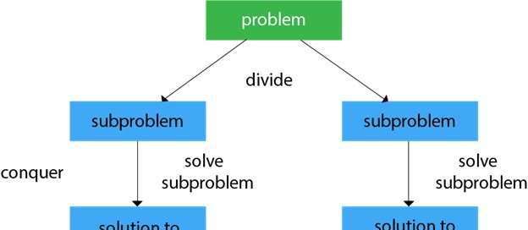
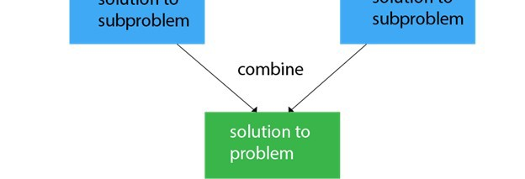
71

Slide 72
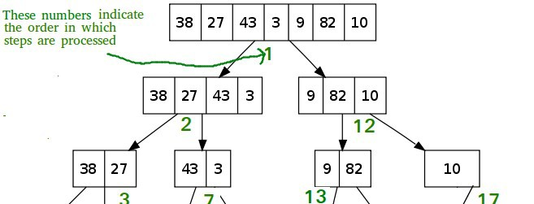
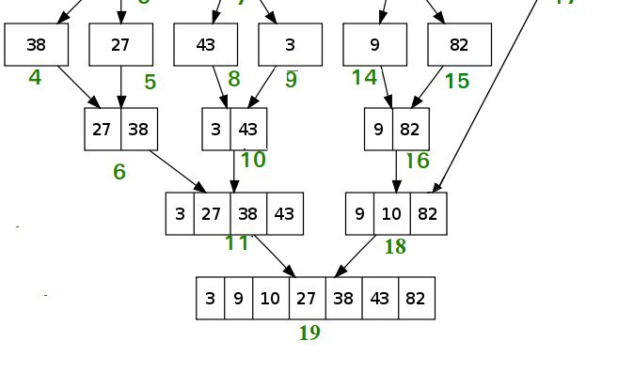
Merge Sort

Slide 73
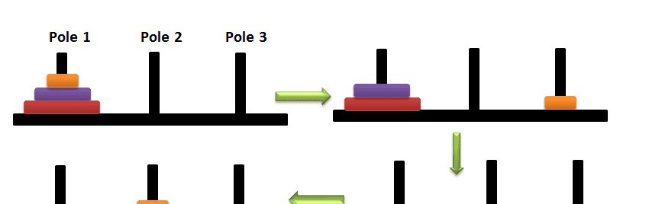
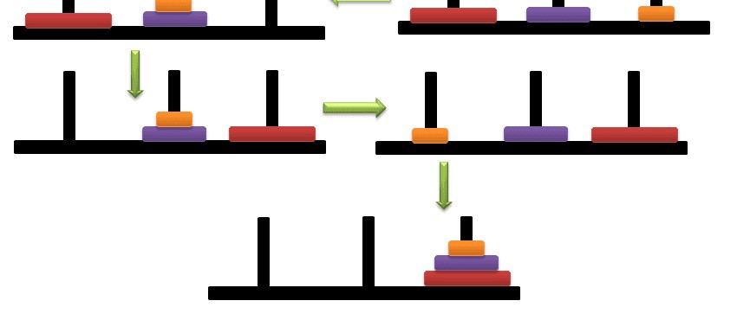
Tower of Hanoi

Slide 74
Advantages of Divide and Conquer
Divide and Conquer tend to successfully solve one of the biggest problems, such as the Tower of Hanoi, a mathematical puzzle. It is challenging to solve complicated problems for which you have no basic idea, but with the help of the divide and conquer approach, it has lessened the effort as it works on dividing the main problem into two halves and then solve them recursively. This algorithm is much faster than other algorithms.
It efficiently uses cache memory without occupying much space because it solves simple subproblems within the cache memory instead of accessing the slower main memory.
Since these algorithms inhibit parallelism, it does not involve any modification and is handled by systems incorporating parallel processing
74

Slide 75
Disadvantages of Divide and Conquer
Since most of its algorithms are designed by incorporating recursion, so it necessitates high memory management.
An explicit stack may overuse the space.
It may even crash the system if the recursion is performed rigorously greater than the stack present in the CP .
75

Slide 76
Greedy Algorithm
Greedy Algorithm is defined as a method for solving optimization problems by taking decisions that result in the most evident and immediate benefit irrespective of the final outcome. It works for cases where minimization or maximization leads to the required solution.

Slide 77
Characteristics of Greedy algorithm
For a problem to be solved using the Greedy approach, it must follow a few major characteristics:
There is an ordered list of resources(profit, cost, value, etc.)
Maximum of all the resources(max profit, max value, etc.) are taken
For example, in the fractional knapsack problem, the maximum value/weight is taken first according to available capacity.

Slide 78
Greedy Algorithm Example:
Some Famous problems that exhibit Optimal substructure property and can be solved using Greedy approach are –
Job sequencing Problem:
Greedily choose the jobs with maximum profit first, by sorting the jobs in decreasing order of their profit. This would help to maximize the total profit as choosing the job with maximum profit for every time slot will eventually maximize the total profit
Prim’s algorithm to find Minimum Spanning Tree:
It starts with an empty spanning tree. The idea is to maintain two sets of vertices. The first set contains the vertices already included in the MST, the other set contains the vertices not yet included. At every step, it considers all the edges that connect the two sets and picks the minimum weight edge from these edges. After picking the edge, it moves the other endpoint of the edge to the set containing MST.

Slide 79
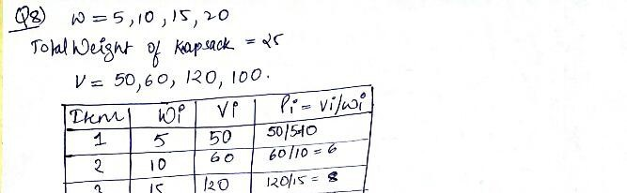
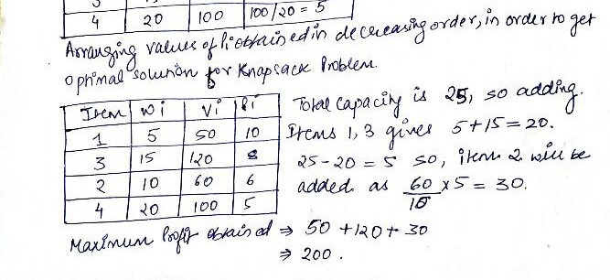
Knapsack Problem

Slide 80
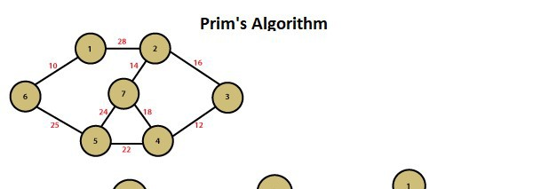
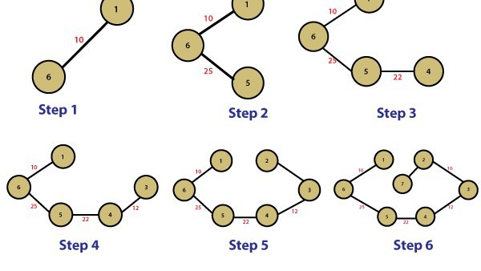
Prims Algorithm
80

Slide 81
References
https://www.enjoyalgorithms.com/blog/steps-of-problem- solving-for-cracking-the-coding-interview
https://asq.org/quality-resources/problem- solving#:~:text=Problem%20solving%20is%20the%20act, The%20problem%2Dsolving%20process
http://www.btechsmartclass.com/data_structures/asympto tic-notations.html
81

